Slide 1

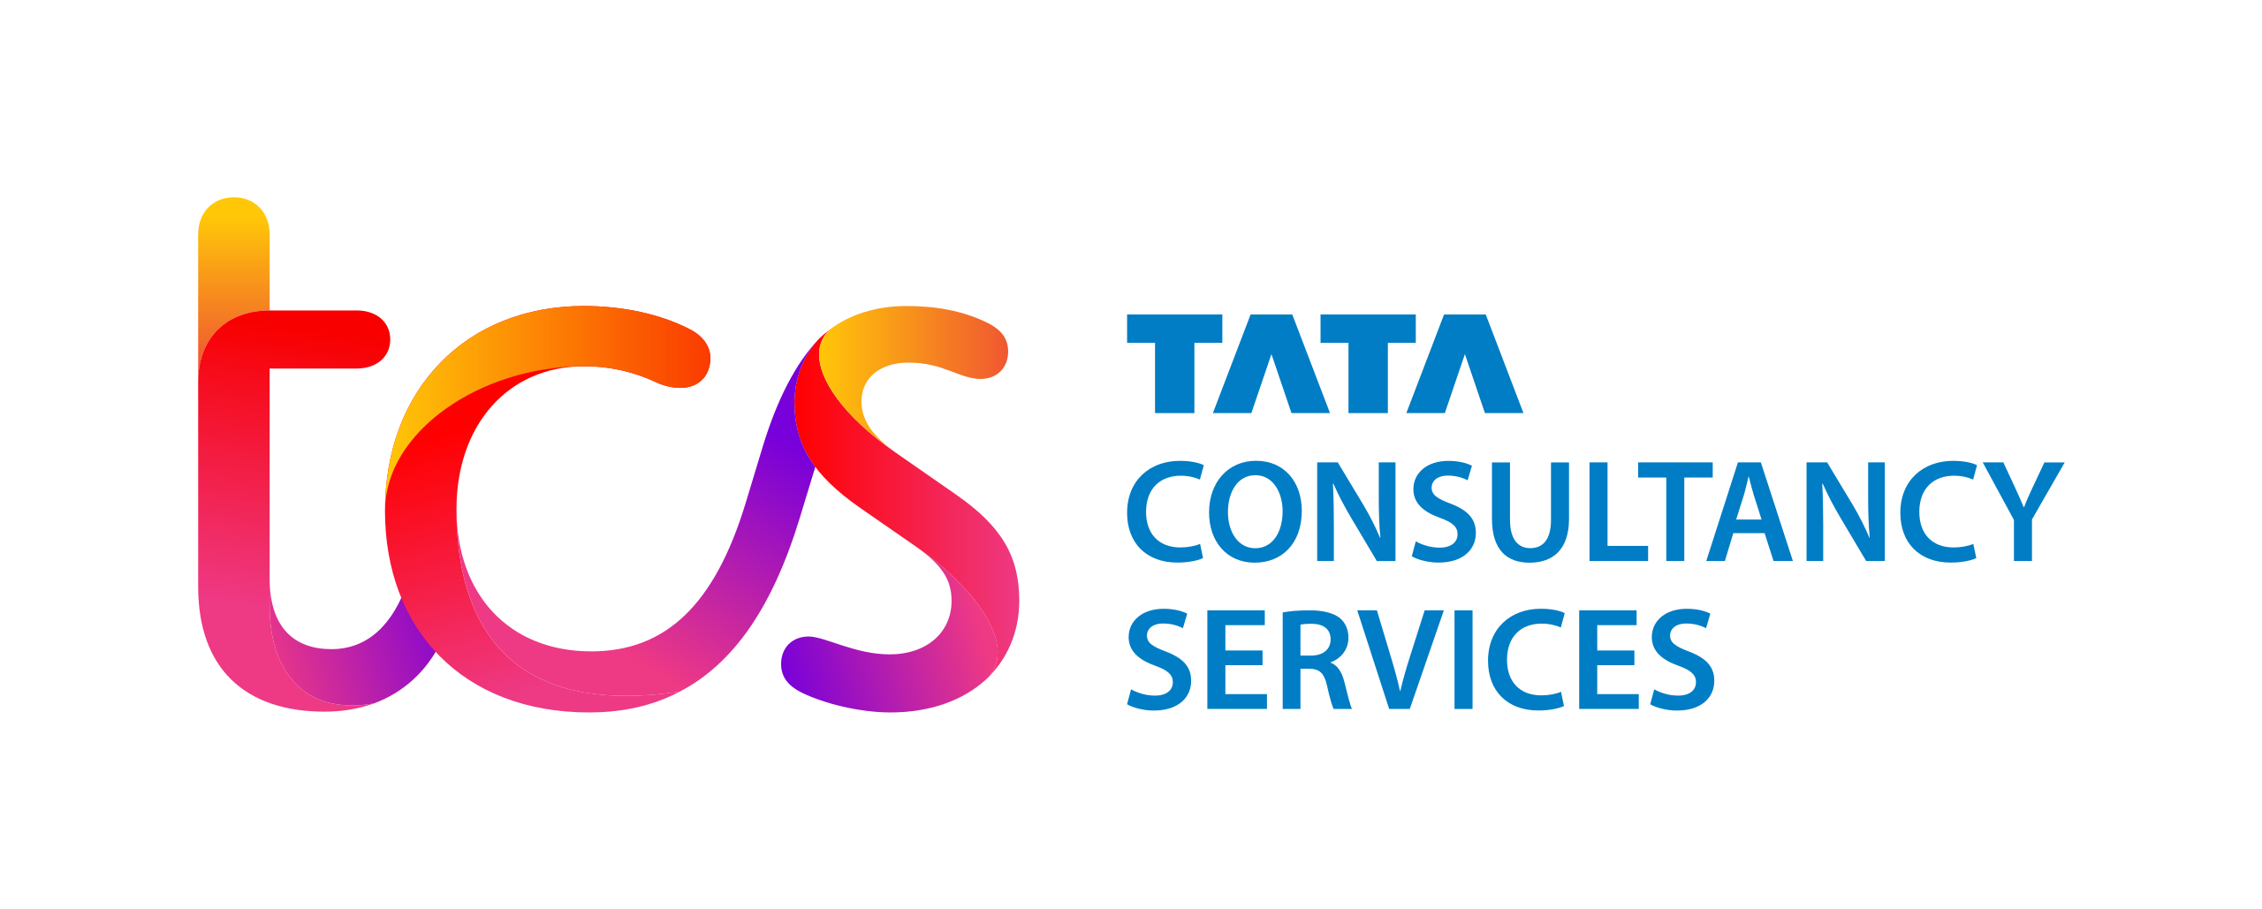
Financial Analytics
St.Clair College

Slide 2
Team Members
c
Prachi Patel – 0775454
Mayur Brahmbhatt – 0775847
Sarjan Patel – 0776451
Devanshi Patel – 0775142
Brian Christian - 0773969

Slide 3

Agenda
Business Summary
Valuation
Ratio Calculation
Technical Analysis & Statistics
Recommendation Analysis

Slide 4
Business Summary
TCS opened India's first software research Centre in Pune, the Tata Research Development and Design Centre. TRDDC conducts research in the areas of software engineering, process engineering, and systems analysis
Tata Consultancy Services (TCS) is a Mumbai-based Indian multinational IT services and consulting firm. It belongs to the Tata Group and has 149 locations in 46 countries.
TCS has operations in various countries. BPS, TRDDC,Innovation labs
Its net worth 177.62 billions USD
TCS's newest Business Process Services are available to their clients. This department is responsible for managing and executing the digital business
TCS established its co-innovation network, which includes innovation laboratories, start-up alliances, university research departments, and venture capitalists, in 2007. TCS also has 19 innovation laboratories

Slide 5
Valuation
5,780
We are getting the beta value of 0.59, which is less than 1 so, we can say that it is less risky
7,930
We took NIFTY 100 as Indian market index
2,500
Its average dividend growth rate is -3 percent, which is a negative value, implying that the company's dividend rate is declining
5,640
We get the current price of 314.07 by implementing the dividend growth model and using the rate of return and average dividend growth

Slide 6
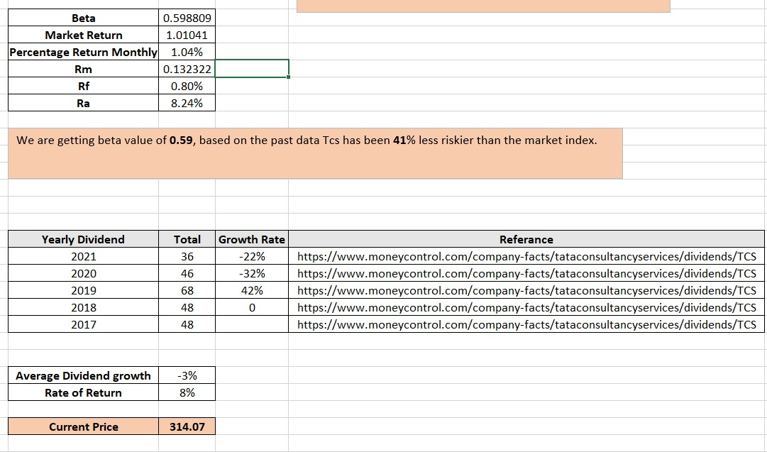

Slide 7
Ratio Calculation First, we identify some of the specific variables that are required to calculate financial ratios
Liquidity Ratio
Dividend payout ratio
01
Dividend payout ratio
02
current, quick, cash
Profitability Ratio
06
Debt-to-equity
03
Gross profit margin (GPM)
Operating profit margin (OPM)
Return on assets (ROA)
Return on equity (ROE)
Return on sales (ROS)
Return on investment (ROI)
Organization’s sustainable growth rate
04
05
Price-earning Ratio

Slide 8
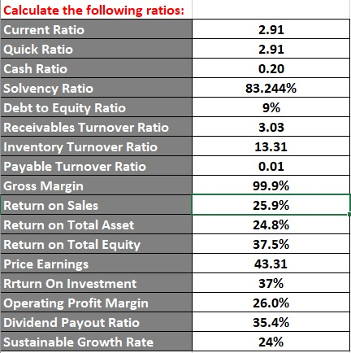

Slide 9
Technical Analysis & Statistics
Bollinger bands are a famous technical evaluation approach in inventory trading
Using the median band, we buy or promote the inventory
We used a year's worth of data and found an upward trend
TCS's trend has rocketed from roughly 3200 to 3800 INR in the month of October, which is almost a 6000 INR growth. However, we can see a dip in November 2021 where the price dropped to 3400 INR, and after that, it is gradually increasing
We can also additionally purchase the inventory in January 2022, consistent with the plot, because it's miles lower, and it'll climb, consistent with the plot the usage of Bollinger bands

Slide 10

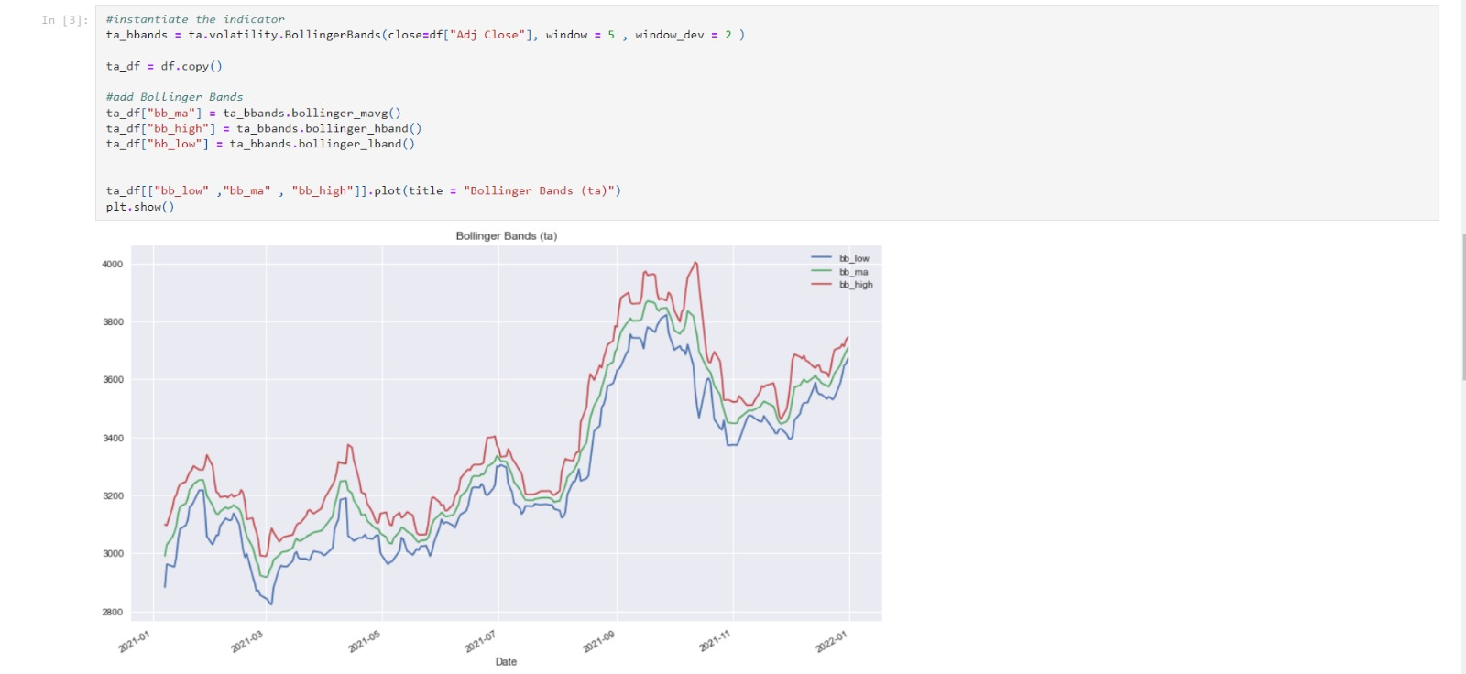

Slide 11
Recommendation
Beta is one of the main pillars of the CAPM
Beta helps us quantify the relationship between security and the overall market portfolio
This stock should be held by an investor
A beta of less than 1 is less risky. And we get a beta value of 0.5
Furthermore, the Bollinger chart shows an upward trend, indicating that the investor should keep it for the time being and sell when the price reaches its peak

Slide 12
Thank You !!

